Slide 1
ZKP & Blockchain to prevent fake account creation on social media sites

Slide 2
Our Idea
Imaginary social media -> signup process
For Govt. entity -> simulator of Govt. entity (integrate real blockchain)
Hashing app
Next level - Plugin for facebook (browser based)
What if anybody creates fake hash value - Govt entity will play role here
Signup -> check blockchain -> check from Govt entity if it is a real user/citizen
Generate hash using multiple user identity (NID, Passport)
Goal is “I DO NOT WANT TO TRANSFER MY REAL DATA”

Slide 3
Our Idea: Digital Identity
Using hash function with parameters (NID, passport, driving license, mobile)
Unique Identifier -> separate app which will create the hashed value, app can not transfer data over the network, network permission of device will be disabled
Hackers can obtain hashed value from facebook server -> using blockchain it can be secured
Facebook will search hash -> in blockchain ledger -> If already exists in ledger facebook will not allow signup
I do not want to share my nid, mobile, passport, driving license
Digital identity solution SSI or something like that

Slide 4
ZKP Idea Formulation
Facebook will check in its network
Then facebook will check in Govt. private network - if its a real human/citizen
Implement blockchain network, smart contract
Check If there is already any published blockchain network
Try improve SSI and name it BSSI (block chain based SSI)
Try to think about some attacks, security attacks
Attacks for public blockchain network
If attacker obtain hash value of a user
Attack scenario: cross social network cloning attack
You have a fb account, don't have twitter account, if attacker obtain fb hash and tries to create twitter account
Possible solution: public key crypto system (dont store hash value plain text form into blockchain, encrypt and store, think on it)
Work on idea first, implementation can be done

Slide 5
ZKP: Definition
Enable a prover to convince a verifier of the validity of a statement
Zero knowledge proofs are a type of cryptography that keeps the details of a transaction hidden
The method was first developed during the 1980s by a group of mathematicians.
Zcash was the first cryptocurrency to deploy the technology, but others have since followed.
Notes:
https://www.slideshare.net/SSIMeetup/zeroknowledge-proofs-privacypreserving-digital-identity-with-clare-nelson?from_search=5
https://slideplayer.com/slide/5028701/

Slide 6
ZKP: Other Definition
A zero-knowledge proof is a method used in cryptography to prove that something is known without revealing the known information directly. It essentially allows private information to be kept secret in an exchange. Zero-knowledge proofs are indirect proofs allowing you to prove you know a secret without ever revealing the secret to anyone else. You prove only that you’re telling the truth
Notes:
https://decrypt.co/resources/zero-knowledge-proofs-explained-learn-guide

Slide 7
Prover and Verifier
In zero-knowledge proofs, the basic roles are the prover and verifier. The prover must prove they know the secret. The verifier must be able to verify the prover is telling the truth.
It works because the verifier asks the prover to do things that can only be done if the prover definitely knows the secret. If the prover is guessing, he or she will eventually be proven wrong by the verifier’s tests. If the secret is known, then the prover will pass the verifiers test every time without a problem. It's like when a bank or institution asks you for letters of a known secret word to verify your identity. You're not telling the bank what's in your bank account, you're merely telling them that you know the sequence of a given word.
Notes:
https://decrypt.co/resources/zero-knowledge-proofs-explained-learn-guide

Slide 8
ZKP Properties
Completeness
if the statement is true, an honest verifier (that is, one following the protocol properly) will be convinced of this fact by an honest prover.
Soundness
if the statement is false, no cheating prover can convince an honest verifier that it is true, except with some small probability.
Zero-knowledge
if the statement is true, no verifier learns anything other than the fact that the statement is true.

Slide 9
ZKP History
1985- The first zero-knowledge proofs were written about in a paper called "The Knowledge Complexity of Interactive Proof-Systems" by Shafi Goldwasser, Silvio Micali, and Charles Rackoff.
2012- Alessandro Chiesa and a team of researchers coin the term zk-SNARKs.
2016- Zcash is released and becomes the most used privacy-focused cryptocurrency to use zk-SNARKs .

Slide 10
Motivation for ZKP and Digital Identity
Loss of privacy, control
Data breaches
Identity theft
Identity fraud, crime
Human, drug trafficking
Terrorist funding
Surveillance, profiling
Social engineering
Notes:
https://www.slideshare.net/SSIMeetup/zeroknowledge-proofs-privacypreserving-digital-identity-with-clare-nelson?from_search=5

Slide 11
Why ZKP?
Users can prove identities
No exchange of sensitive information
Mitigates identity theft

Slide 12
ZKP variants
ZKP
NIZKP
Graph Isomorphism
zk-SNARK
zk-STIK
zk-STARK
Designated Verifier
Bulletproof
Lattice-Based

Slide 13
IZKP and NZKP
In IZKP message exchange between prover and verifier
In NZKP transform multiple messages into one message, or string
Notes:
https://academy.moralis.io/blog/understanding-zero-knowledge-proof-technology#:~:text=Zero-knowledge%20proof%20allows%20one%20user%20%28the%20%E2%80%9CProver%E2%80%9D%29%20to,still%20validate%20that%20the%20Prover%20knows%20the%20secret.
https://slideplayer.com/slide/5028701/
https://www.slideshare.net/eralcnoslen/zeroknowledge-proofs-identity-proofing-and-authentication?from_search=11
https://www.youtube.com/watch?v=itBPUxnSbzY

Slide 14

Zcash founder
One of the most powerful tools cryptographers have ever devised
Matthew Green
Professor at Johns Hopkins University
Co-founder of Zcash

Slide 15
Blockchain Platforms
IBM Blockchain Platform
Microsoft Blockchain Platform
Amazon Managed Blockchain
Ethereum
Hyperledger fabric
Corda

Slide 16
Encryption vs Hashing
Every block uses cryptographic hash
Hashing is not Encryption
Hashing: is not reversible , not possible to get back original data
Encryption: is reversible, possible to get back original data
Hashing string -> fixed length output
3 properties of output
Can not be reversed/decrypted
2 input hashed, single character difference between 2
Can not find 2 string for which hashed value are same

Slide 17
Blockchain Types
Public blockchain
Private blockchain
Permissionless blockchain
Permissioned blockchain
Hybrid blockchain
Consortium or Federated blockchain

Slide 18
Public Blockchain
A public blockchain is one where anyone is free to join and participate in the core activities of the blockchain network. Anyone can read, write, and audit the ongoing activities on a public blockchain network, which helps achieve the self-governed, decentralized nature often touted when blockchain is discussed.
Example: Bitcoin, Ethereum, and Litecoin

Slide 19
Private Blockchain
A private blockchain is one in which only specific users have access and abilities and is generally used only by the entity it belongs to.
Example: Enterprise Ethereum. IBM, Hyperledger, R3 Corda, and Tezos also provide private blockchain services.

Slide 20
Permissioned Blockchain
A permissioned blockchain is a distributed ledger that is not publicly accessible. It can only be accessed by users with permissions. The users can only perform specific actions granted to them by the ledger administrators and are required to identify themselves through certificates or other digital means.
KEY TAKEAWAYS
Permissioned blockchains provide an additional level of security over typical blockchain systems like Bitcoin, as they require an access control layer.
These blockchains are favored by entities who require security, identity, and role definition within the blockchain.
Permissioned blockchains are becoming more common as businesses realize their benefits.
For example, a bank may be running a permissioned blockchain operated through a designated number of nodes internal to the bank to track money transfers. You cannot access this blockchain because you don't have the permissions required. Many cryptocurrency blockchains are permissionless.

Slide 21
Permissionless Blockchain
A permissioned blockchain is a distributed ledger that is not publicly accessible. It can only be accessed by users with permissions. The users can only perform specific actions granted to them by the ledger administrators and are required to identify themselves through certificates or other digital means.

Slide 22
Hybrid Blockchain
Hybrid blockchains use both private and public blockchains, rather than being a standalone solution.
“In the end, it’s just one private blockchain plus one public blockchain,” Strehle said.
With hybrid blockchains, a company may put their data or transactions on a private blockchain to keep the information confidential but put a digital fingerprint of the data on a public blockchain to secure it, said Strehle. If a company suspects the data may have been altered, it can compare the information on the private blockchain with the reconstructed information taken off the public blockchain fingerprint, he added.
Notes:
https://builtin.com/blockchain/private-blockchain

Slide 23
Consortium or Federated Blockchain
Consortium or federated blockchains operate with a particular group of participants who control the blockchain, rather than a single entity. This group sets the rules, edits or cancels incorrect transactions and solicits cooperation among its members, according to a Blockchain Council report.

Slide 24
Self Sovereign Identity (SSI)
Self-sovereign identity (SSI) is a model for managing digital identities in which individuals or businesses have sole ownership over the ability to control their accounts and personal data.
Notes:
https://www.techtarget.com/searchsecurity/definition/self-sovereign-identity

Slide 25
Secure Multiparty Computation
Secure multiparty computation (MPC / SMPC) is a cryptographic protocol that distributes a computation across multiple parties where no individual party can see the other parties’ data.
The secure multiparty computation protocol leverages a well-established cryptographic concept called additive secret sharing, which refers to the division of a secret and its distribution among a group of independent, willing participants.
For example, If the number of nodes is ten and the threshold needed to sign a transaction is five, then the attackers would need to break into six nodes and steal the key shares. This is made more difficult by proactive security measures like key rotation that automatically move sensitive private key material between nodes.
Assuming the MPC is implemented on secure hardware, this need to attack simultaneously on multiple fronts makes MPC significantly more secure than other private key storage methods like hot and cold crypto wallets which have a single point of failure

Slide 26
sMPC: Use Cases
salary sharing
sealed-bid auction highest bidder
genetic testing
sensitive research
Notes:
https://inpher.io/technology/what-is-secure-multiparty-computation/
https://www.qredo.com/blog/what-is-multi-party-computation-mpc

Slide 27
Shamir’s Secret Sharing Algorithm
Shamir’s Secret Sharing scheme is an important cryptographic algorithm that allows private information— “secrets” — to be distributed securely amongst an untrusted network.
Shamir’s Secret Sharing scheme is an algorithm that was first proposed in 1979 by the renowned Israeli cryptographer Adi Shamir. It allows for information to be broken into many shares, while only requiring a fraction of those shares to reconstruct the original secret.
This means that, instead of requiring all shares to reconstruct the original secret, Shamir’s scheme requires a minimum number of shares — this minimum is referred to as the threshold.
One of the benefits of Shamir’s algorithm is that it is flexible and extensible — meaning that the secret owner could add, amend or remove shares at anytime if they wanted to, without modifying the original secret.
Secret sharing algorithms
Shamir’s secret sharing algorithm
Rabin’s Information Dispersal
Notes:
https://medium.com/@keylesstech/a-beginners-guide-to-shamir-s-secret-sharing-e864efbf3648
https://app.pluralsight.com/library/courses/applied-cryptography-getting-started/table-of-contents

Slide 28
Claim Identity Model
Notes:
https://en.wikipedia.org/wiki/Claims-based_identity
https://www.techtarget.com/searchsecurity/definition/claims-based-identity
https://www.techtarget.com/searchsecurity/definition/claims-based-identity

Slide 29
Blockchain: Consensus Algorithms
Proof of Work (PoW)
Proof of Authority
Proof of Stake (PoS)
Delegated Proof of Stake (DPoS)
Leased Proof of Stake (LPoS)
Proof of Importance (PoI)
Direct Acyclic Graph (DAG)
Notes:
https://www.decipherzone.com/blog-detail/consensus-algorithms

Slide 30
Blockchain: Elements
Peer to peer network
Cryptography
Consensus algorithms

Slide 31
Blockchain: Examples
Bitcoin
Ethereum
Monero

Slide 32
Open Public Blockchain
Open public blockchain:
open to everybody,
Transnational,
borderless,
no selected participants
Censorship resistant: can not remove a record or stop being published
No 3rd party
Neutral
No good, bad, legal, illegal transaction
Only valid or invalid transaction
No single point of failure
Immutable/ temper proof

Slide 33
Closed Private Blockchain
private to selected participants

Slide 34
Blockchain: Smart Contract
These basic components are the properties (static and variable), the logic and the ledger. Each of these components can be mapped directly into technical concepts. Properties represent a data schema, logic represents code, and the ledger corresponds to a database
What is a real life example of a smart contract?
A smart contract is a self-executing program based on if-then logic. For example, vending machines are a ubiquitous presence in everyday life. It's also a simple model of a smart contract: If someone inserts $2 and then presses B4, then the machine dispenses the package of cookies held in the B4 slot
On blockchain, the goal of a smart contract is to simplify business and trade between both anonymous and identified parties, sometimes without the need for a middleman.
Notes:
https://www.geeksforgeeks.org/smart-contracts-in-blockchain/

Slide 35
What to Check
ZKP based signup, sign in not exists
implementation exists SSI already

Slide 36
Paper 02: A zero-knowledge-proof-based digital identity management scheme in blockchain, 2020
The traditional centralized digital identity management system (DIMS) has been subject to threats such as fragmented identity, single point of failure, internal attacks and privacy leakage. Emerging blockchain technology allows DIMSs to be deployed in it, which largely alleviates the problems caused by the centralized third party, but its inherent transparency and lack of privacy pose a huge challenge to DIMSs. In this regard, we leverage the smart contracts and zero-knowledge proof (ZKP) algorithms to improve the existing claim identity model in blockchain to realize the identity unlinkability, effectively avoiding the exposure of the ownership of attributes. Furthermore, we implement a system prototype named BZDIMS that includes a challenge-response protocol, which allows users to selectively disclose their ownership of attributes to service providers to protect users’ behavior privacy. Performance evaluation and security analysis show that our scheme achieves effective attribute privacy protection and a wider application scope compared with the prior model.
Notes:
https://drive.google.com/file/d/1KW0diPDqJthlUa1P8EnazUguoUv7qjZD/view

Slide 37
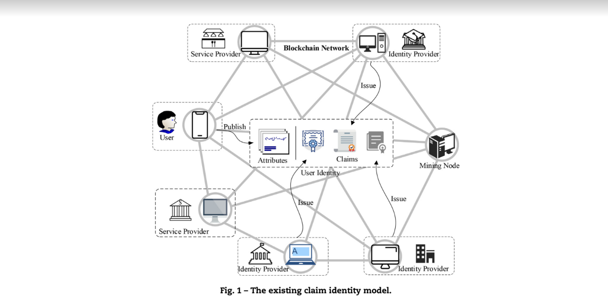
Paper 02: Existing Claim Identity Model

Slide 38
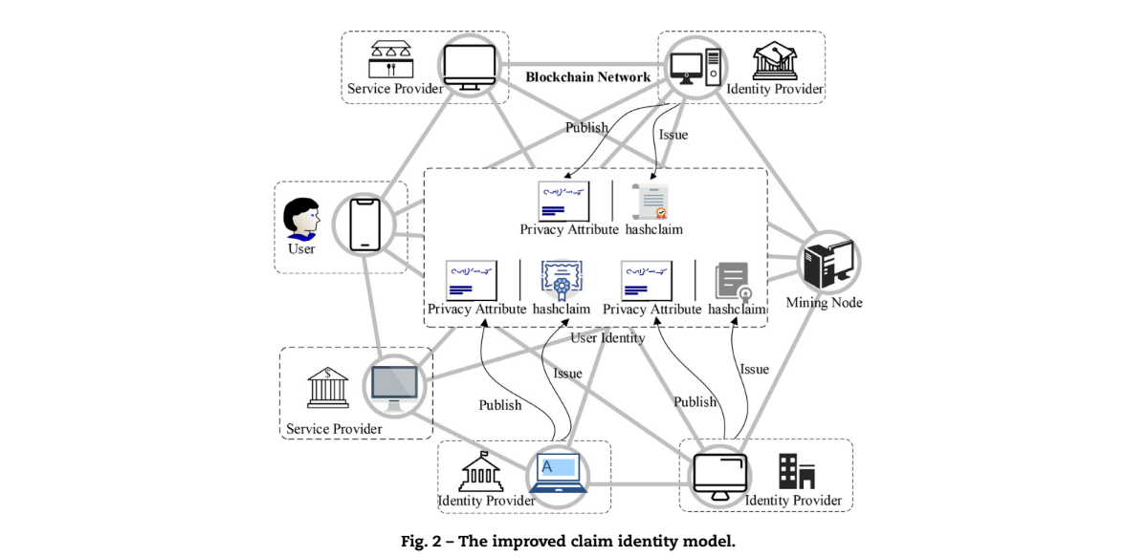
Paper 02: Improved Claim Identity Model

Slide 39
Paper 02: Terminologies Used
Entity (IdP, SP)
Attribute (name value pair, possession, Endorsement)
Identifier
Claim
Hashclaim
Identity
Profile
Notes:
https://drive.google.com/file/d/1KW0diPDqJthlUa1P8EnazUguoUv7qjZD/view

Slide 40
Paper 02: Blockchain
Since the birth of Bitcoin (Nakamoto, 2019) in 2009, cryptocurrencies have brought a huge impact on traditional finance. Blockchain, as the core technology of Bitcoin, is a dis- tributed ledger technology. Peers in blockchain connect the blocks in chronological sequence into a specific data structure in a chain manner and use cryptography to guarantee strong unforgeability and integrity. Since everyone can host the distributed ledger, the transaction does not depend on intermediaries. The transaction process is transparent, traceable and tamper-proof, thereby establishing a robust trust system in a distributed and trustless scenario.
Besides, according to whether peers need authorization when joining or exiting the blockchain system, blockchains can be divided into two types: permissionless blockchains and permissioned blockchains.
Notes:
https://drive.google.com/file/d/1KW0diPDqJthlUa1P8EnazUguoUv7qjZD/view
Section 3.1

Slide 41
Paper 02: Smart Contract

Slide 42
Paper 02: Zero Knowledge Proof
Zero-knowledge proof (ZKP) is a cryptographic technique, which means that the prover can convince the verifier that a certain statement is correct without providing the verifier with any additional information or leaking any information about the witness.
According to whether there is a challenge-response interaction, ZKP algorithms can be divided into two kinds: interactive and non-interactive (Lesavre et al., 2019).
In all, zk-SNARK enables us to achieve the design of privately transferring the possession of the attribute in public blockchain with minimal computational overhead.

Slide 43
Paper 02: Zokrates
ZoKrates (Eberhardt and Tai, 2018), based on zk-SNARK algorithm Groth17 (Groth and Maller, 2017), provides a processing model for off-chain computing and on-chain verifying in Ethereum. More importantly, ZoKrates is a toolbox that consists of a domain-specific language (DSL), a compiler and generators for witness and proof.
Notes:
https://www.youtube.com/watch?v=sSlrywb5J_0

Slide 44
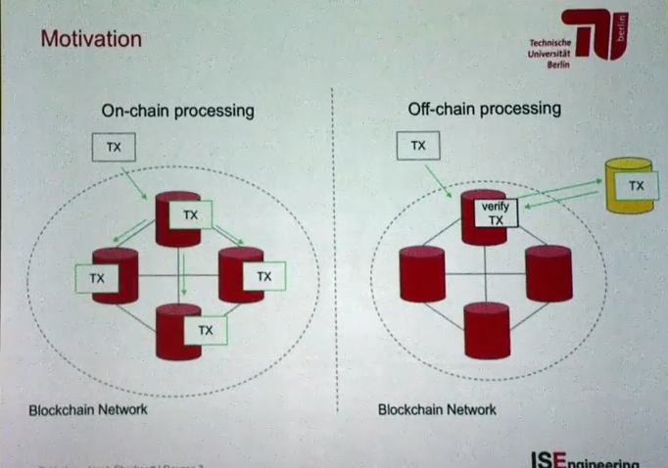
Notes:
https://www.youtube.com/watch?v=sSlrywb5J_0

Slide 45
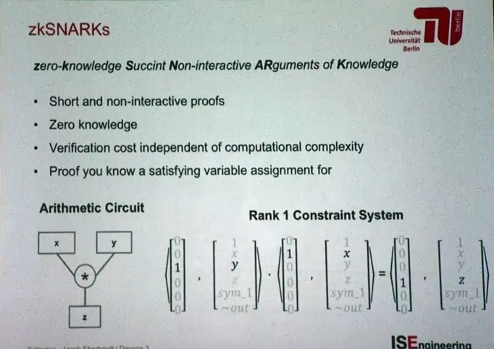

Slide 46
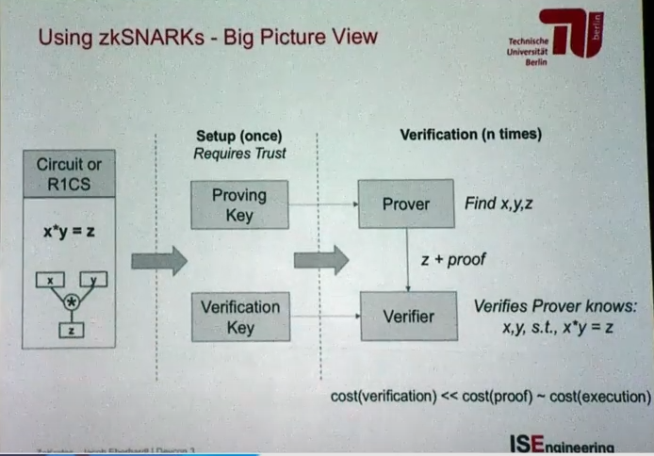

Slide 47
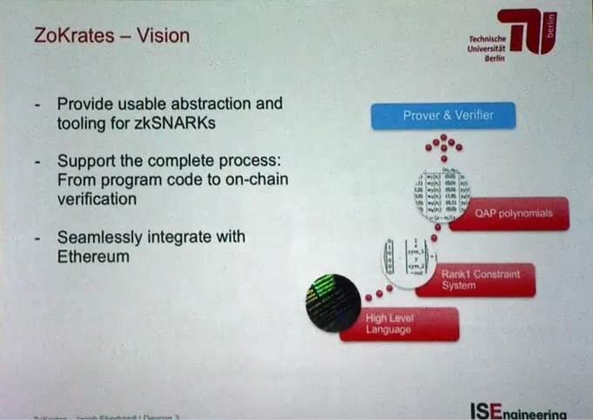

Slide 48
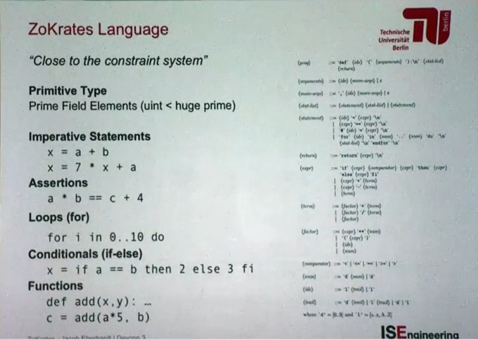

Slide 49
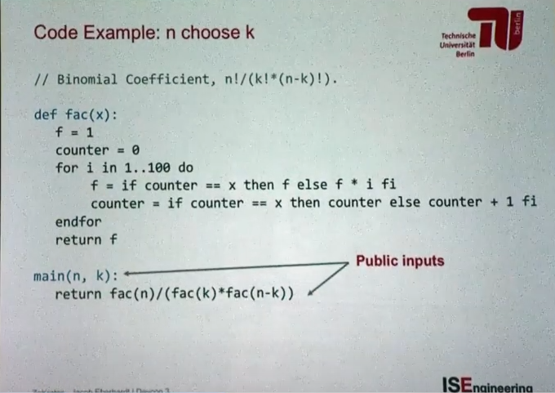

Slide 50
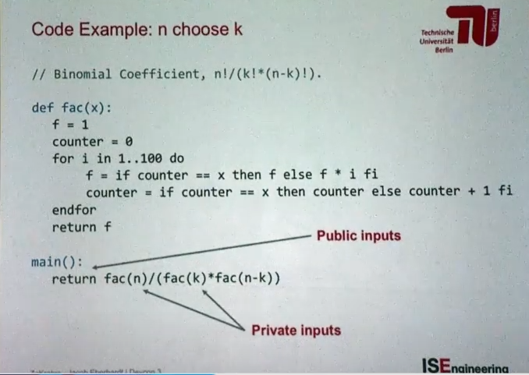

Slide 51
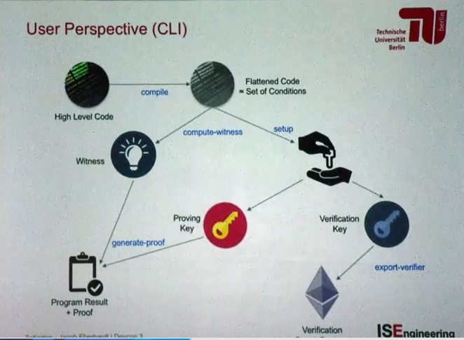

Slide 52
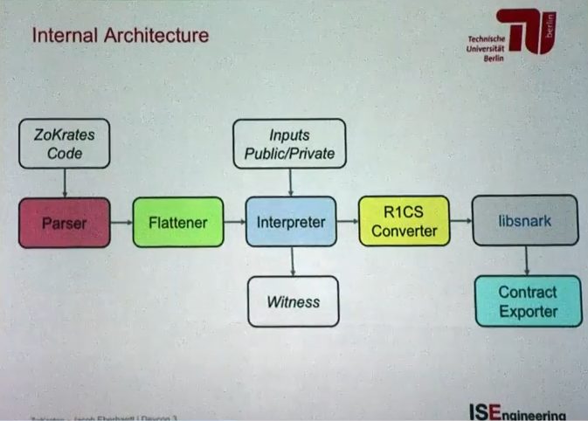

Slide 53
Example
F = sqrt(n)
Prover finds sqrt(n) where n is a public number
And proves to the verifier that he knows that number
Notes:
https://www.youtube.com/watch?v=_ZvGZxhCFfE

Slide 54
Paper 02: Blockchain-based Interoperable Healthcare Using Zero-knowledge Proofs and Proxy Re-Encryption
Problem
Healthcare service provider stores patients data with inadequate layer of security and firewalls, which results in data breaches. “Clearing House” third party to validate insurance claim, risk of data leaks
Achievement
National blockchain framework for Patients Electronic Health Records access control. Transparent insurance claim process using smart contract. Smart card approach to authenticate identity using ZKP
Entities
Hospitals, Patients, Govt. Agencies, Insurance Company, Insurance Claim Validator
Introduce novel authentication mechanism using zkp
Proposed a layered smart contract to manage access control permission, insurance claim, proof of identity for medical data

Slide 55
Paper 03: A Survey of Zero-Knowledge Proof for Authentication, 2015
Zero knowledge password auth
Zero knowledge password auth with public key encryption (added security)
P2P identity auth based on ZKP:
Phase 1: preprocessing
Phase 2: identity auth
Notes:
https://drive.google.com/file/d/15_rKR1Amal1ZUl26kE1kjoSxacl_9xvZ/view

Slide 56
Paper 04: Self sovereign and blockchain based access control: Supporting attributes privacy with zero knowledge, 2023
Abstract
aimed at bringing users back at the center of digital systems
In this paper we show how it is possible to apply this increasingly popular concept(decentralized systems, in line with the Self Sovereign Identity paradigm) to a traditionally centralized and opaque digital process: Access Control systems
Attribute Based Access Control systems with the novel concept of private attributes
we show how to leverage smart contracts and zero knowledge proofs to allow for transparent policies evaluation without disclosing the value of such sensible attributes
Beside formalizing our goals, presenting the system architecture, and discussing its advantages and drawbacks with respect to the traditional model
Introduction
decentralization and the bringing of users back in control of their data
proposals clearly follow the Self Sovereign Identity (SSI) paradigm (Preukschat and Reed, 2021), by shifting control from the platforms where data is generated to the owners of said data
With this respect, the European Commission is pushing towards this paradigm with the eIDAS framework, which allows the usage of national identity credentials all over the member states (European Union, 2014, Joinup, 2022). In SSI, credentials are signed and issued to subjects by issuers. Subjects, in turn, sign and show them to verifiers who accept them if, alongside satisfying the conditions, they are signed by trusted issuers. Subjects are responsible of storing their credentials on their premises, similarly to the covid-19 certificates used in EU. SSI is not a new concept (Loffreto, 2012), but only recently mature enough tools to support it have been made available. In fact, SSI has found suitable ground in the recent decentralized web (web3) (Web3, 2022) revolution, which, in turn, was largely made possible by the affirmation of blockchain technology.
Access Control Systems (ACSs). Access Control Systems typically require information about users to operate, called attributes, e.g., an user role inside a company to access a given benefit, yet users do not partake at all in the management of such information.

Slide 57
Paper 05: Self-Sovereign Identity Solution for Blockchain-Based Land Registry System: A Comparison, 2022
Notes:
https://www.hindawi.com/journals/misy/2022/8930472/

Slide 58
Paper 06: Extending web applications with a lightweight zero knowledge proof authentication

Slide 59
Paper 07: Self sovereign and blockchain based access control: Supporting attributes privacy with zero knowledge
To this aim we expand the XACML standard for Attribute Based Access Control systems with the novel concept of private attributes, i.e. attributes whose values should not be disclosed while still contributing to a policy evaluation result after user consent. Basing our proposal on blockchain systems, we show how to leverage smart contracts and zero knowledge proofs to allow for transparent policies evaluation without disclosing the value of such sensible attributes.
Concept used: Access Control, ZKP, smart contract
Notes:
https://www.sciencedirect.com/science/article/abs/pii/S1084804522002181

Slide 60
Paper 08: Permissioned Blockchain and Deep Learning for Secure and Efficient Data Sharing in Industrial Healthcare Systems, 2022
Motivation
real-time monitoring of patients
data sharing among intelligent wearable devices and sensors
this connectivity brings the intrinsic vulnerabilities related to security and privacy due to the need of continuous communication and monitoring over public network (insecure channel)

Slide 61
Permissioned Blockchain and Deep Learning for Secure and Efficient Data Sharing in Industrial Healthcare Systems, 2022
Our Work
We integrate permissioned blockchain and smart contract with deep learning (DL) techniques to design a novel secure and efficient data sharing framework named PBDL
PBDL first has a blockchain scheme to register, verify (using zero-knowledge proof), and validate the communicating entities using the smart contract-based consensus mechanism.
Second, the authenticated data are used to propose a novel DL scheme that combines stacked sparse variational autoencoder (SSVAE) with self-attention-based bidirectional long short term memory (SA-BiLSTM).
In this scheme, SSVAE encodes or transforms the healthcare data into new format, and SA-BiLSTM identifies and improves the attack detection process.

Slide 62
Permissioned Blockchain and Deep Learning for Secure and Efficient Data Sharing in Industrial Healthcare Systems, 2022
Experimental Results
The security analysis and experimental results using IoT-Botnet and ToN-IoT datasets confirm the superiority of the PBDL framework over existing state-of-the-art techniques.

Slide 63
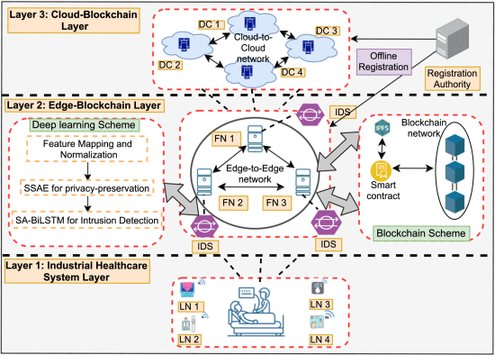
Permissioned Blockchain and Deep Learning for Secure and Efficient Data Sharing in Industrial Healthcare Systems, 2022
System Architecture
Notes:
LN - lightweight node

Slide 64
Paper 09: Traceable Revocable Anonymous Registration Scheme with Zero-knowledge Proof on Blockchain

Slide 65
Article 01: Facebook ML Fake Accounts
It (Facebook) blocks millions of attempts to create accounts every day, says Gharbaoui, using a machine learning model that is designed to very quickly process a high volume of information and make rapid decisions. Facebook won't describe the precise features that could lead to blocked signups, arguing that to do so would provide bad actors with too much information, but factors like the IP address of the request and the volume from that location are the kinds of information that are likely to be considered, among others.
the quality of fake accounts on social media platforms has improved dramatically in recent years.
Today's more advanced approaches to fake account creation use machine learning to generate increasingly realistic profiles, said Shuman Ghosemajumder, global head of artificial intelligence systems at F5 Networks. They are able to create convincing-sounding names and biographies, and even entirely synthetic images that are almost impossible to discern from genuine photographs of real humans.
Currently, 20,000 are used for DEC's decision-making.
Notes:
https://www.protocol.com/facebook-machine-learning-fake-accounts

Slide 66
ZKP: With Example
https://blog.goodaudience.com/understanding-zero-knowledge-proofs-through-simple-examples-df673f796d99

Slide 67
Blockchain Video
Blockchain 101, part 1
https://www.youtube.com/watch?v=_160oMzblY8
Blockchain 101, part 2
https://www.youtube.com/watch?v=xIDL_akeras
How does blockchain work
https://www.youtube.com/watch?v=SSo_EIwHSd4
TED Talk
https://www.youtube.com/watch?v=k53LUZxUF50
99Bitcoins
https://www.youtube.com/watch?v=2yJqjTiwpxM

Slide 68
2018 Papers

Slide 69
A Survey of How to Use Blockchain to Secure Internet of Things and the Stalker Attack
Journal: Security and Network Communication (SNC)

Slide 70
2019 Papers

Slide 71
2019 Applications of Blockchain Technology in Medicine and Healthcare Challenges and Future Perspectives

Slide 72
2019 Blockchain Implementation in Health Care Protocol for a Systematic Review

Slide 73
2019 Blockchain Technology in Healthcare A Comprehensive Review and Directions for Future Research.pdf

Slide 74
2019 Blockchain-Based Applications in Education A Systematic Review

Slide 75
2019 Blockchain-Enabled iWellChain Framework Integration With the National Medical Referral System Development and Usability

Slide 76
2019A_Secure_Healthcare_System_Design_Framework_using_Blockchain_Technology

Slide 77
2020.1 A Blockchain-Based Smart Contract System for Healthcare Management

Slide 78
2021.1 A Hyperledger Fabric-Based System Framework for Healthcare Data Management
2.2 Blockchain
2.2.1 Blockchain 1.0 – Bitcoin
2.2.2 Blockchain 2.0 – Smart Contracts
2.2.3 Hyperledger Fabric
2.3 abc

Slide 79
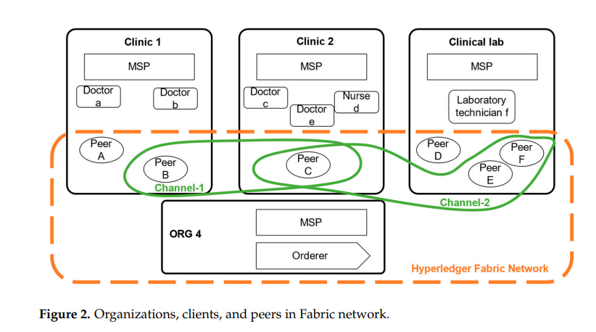

Slide 80
2021.3 SPChain Blockchain-based Medical Data Sharing and Privacy-preserving eHealth System
Mathematical notation described

Slide 81
Cryptography
Notes:
https://intellipaat.com/blog/what-is-cryptography/?US

Slide 82
Secret Question using GAN

Slide 83
2009 Building Robust Authentication Systems With Activity-Based Personal Questions
A recent study found that the widely-used secret questions for Web authentication can easily be guessed. The study focused on making secret questions easier to remember for the user and harder to break by others. Our approach is authentication through the use of an individual’s personal and dynamic Internet activities. We hypothesize that frequently-changing secret questions will be hard for attackers to guess. We propose three major categories of questions that are based off of user activities: network activities (e.g., browsing history, emails); physical events (e.g., planned meetings, calendar items); conceptual opinions (e.g., opinions as derived from browsing, emails). Our preliminary results are encouraging and show that this new direction is promising. To improve the usability, in particular nonintrusiveness, of such a dynamic secret-question system, we also describe a concrete client-server architecture and security model for automating our authentication systems through utilizing existing artificial intelligent techniques.

